Slide 1
New Peruvian Restaurant in Manhattan city
Capstone Project

Slide 2
A New Peruvian Restaurant in Manhattan, NY.
Introduction to Business Case
Released Questions in the business case
Data Required
Methodology
Results
Recommendations

Slide 3
Introduction to Business Case
A Peruvian entrepreneur wish to open a new Peruvian Restaurant in Manhattan, NY.
Manhattan is associated as the city never sleeps, hence most of restaurants in that borough have achieved economic successes.
Peruvian food have gained high reputation in the last ten year in the world. It is considered one of the best potage in the world.
The gastronomic entrepreneur wants to take advantage of exponential increase of the Peruvian food and open a new Peruvian restaurant in Manhattan.
The question is where will be the optimal neighborhood to initiate the gastronomic business adventure.

Slide 4
Released Question in The Business Case
The following questions should be answered after the evaluation of business case.
How many Peruvian restaurants are in Manhattan?
What is the best location in Manhattan City to open a Peruvian restaurant?
Which are other potential neighborhoods in Manhattan for Peruvian Cuisine?
Which neighborhoods lack Peruvian restaurants?

Slide 5
Data Section
The following data is needed to get the solution for this case.
List of Boroughs, Neighborhoods, as well as the latitudes and longitudes from each neighborhoods in New York: https://cocl.us/new_york_dataset
List of 100 venues around 1000 meters of radius in Manhattan: Foursquare API
Venue data of Peruvian restaurants in Manhattan city: Foursquare API

Slide 6
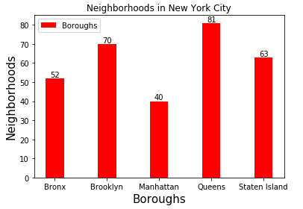
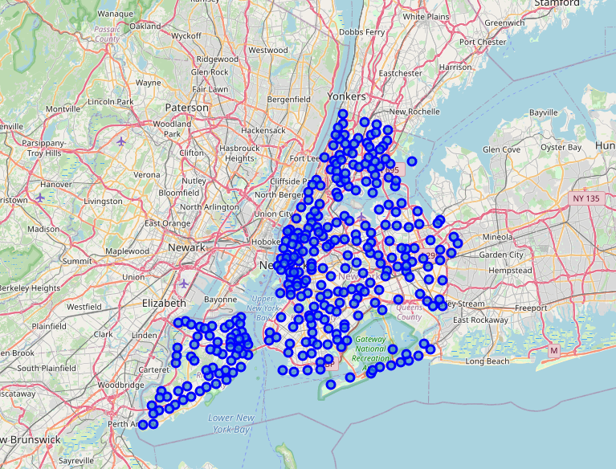
Methodology
Figure 1
Determining the number of borough and neighborhoods in New York. Figure 1 displays that there are 5 boroughs and 306 neighborhoods in New York.
Manhattan counts with 40 neighborhoods.
The figure 2 shows the neighborhoods in a folium map.
Figure 2

Slide 7
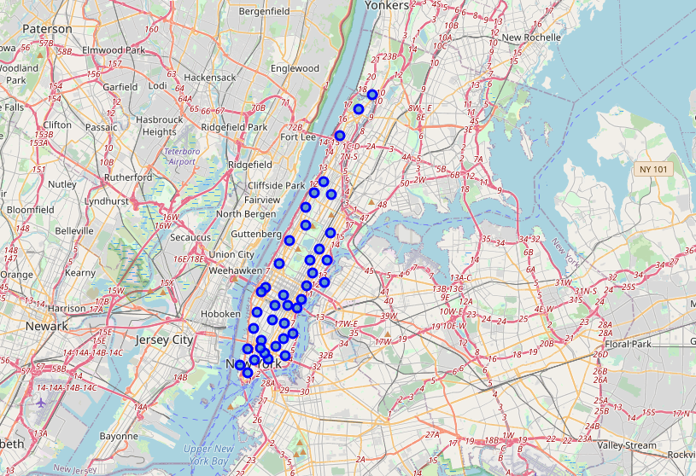
Methodology
Figure 3
As the Peruvian Entrepreneur wants to open a new Peruvian restaurant in Manhattan city, hence the analysis will be focused in Manhattan’s neighborhoods as depicted in the figure 3, Manhattan city counts with 40 neighborhoods

Slide 8
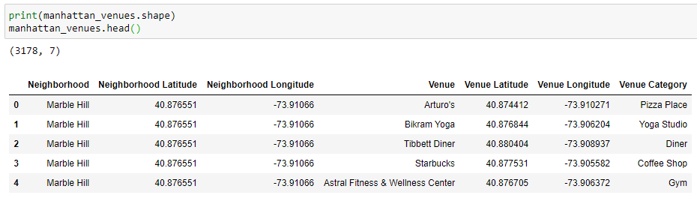
Methodology
Foursquare API with 100 venues of limit and 1000 meters radius is used to obtain the venues from Manhattan, which yields 3178 venues around the city. As shown in table 1, it displays the first five venues in the Marble Hill neighborhood. For a space issue in the report only the first five venues are displayed in Table 1.
Table 1

Slide 9
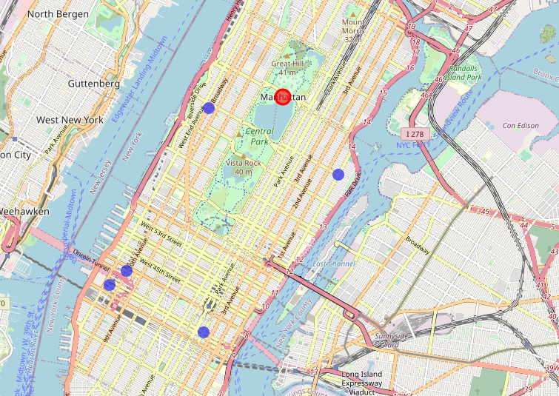
Methodology
Figure 4
Once the venues from Manhattan are converted to data frame, it can be filtered to determine the number of Peruvian restaurants in operation in the city. As shown in the figure 4, there are five Peruvian restaurants around Manhattan city. The information from figure 4 emphasis the great opportunity to initiate a new gastronomic business.

Slide 10
Methodology
Figure 4
Once the venues from Manhattan are converted to data frame, it can be filtered to determine the number of Peruvian restaurants in operation in the city. As shown in the figure 4, there are five Peruvian restaurants around Manhattan city. The information from figure 4 emphasis the great opportunity to initiate a new gastronomic business.

Slide 11
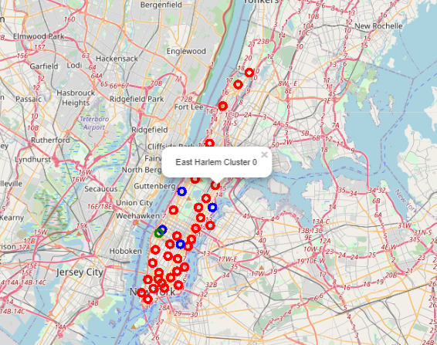
Methodology
Figure 4
K-means clustering method is used to cluster the existing Peruvian restaurants by neighborhood. As depicted in figure 5, the Manhattan neighborhoods are grouped into three clusters. The blue cluster contains four restaurants, the green cluster contains one, and the red cluster doesn’t have any Peruvian restaurant
The figure 4 depicts that the gastronomic business can be opened in any of the neighborhoods located in the red cluster. .

Slide 12
Results
How many Peruvian restaurants are in Manhattan? Five Peruvian restaurants around Manhattan
What is the best location in Manhattan City to open a Peruvian restaurant? The best place for opening a new Peruvian restaurant is in the red clustered neighborhoods, not far from an existing restaurant on the blue cluster. For example, a possible optimal location could be the East Harlem neighborhood
What are other potential neighborhoods in Manhattan for Peruvian Cuisine? Open the restaurant in the red clustered neighborhood but far away from the blue cluster, it can be an excellent opportunity to obtain new customers without any similar competition around the neighborhood
What neighborhoods lack Peruvian restaurants?
The Manhattan neighborhoods in the red cluster don’t have a Peruvian restaurant, a great business opportunity to open a new Peruvian restaurant in one of these neighborhoods.

Slide 13
Recommendation
Based on the evaluation made, the Manhattan city provides a great business opportunity to initiate a new gastronomic business of Peruvian food. The document shows that there are only five Peruvian restaurants around Manhattan city where each restaurant is in a different neighborhood. Thirty-five neighborhoods in Manhattan don’t have Peruvian restaurants. Therefore, a new Peruvian restaurant can be opened in one of these neighborhoods, not far from an existing Peruvian restaurant located in the blue cluster, for instance in the East Harlem neighborhood.

